Slide 1
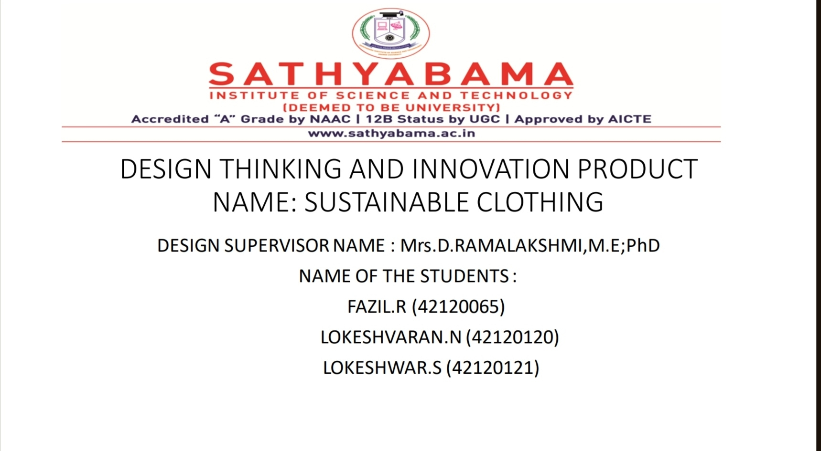

Slide 2


Slide 3
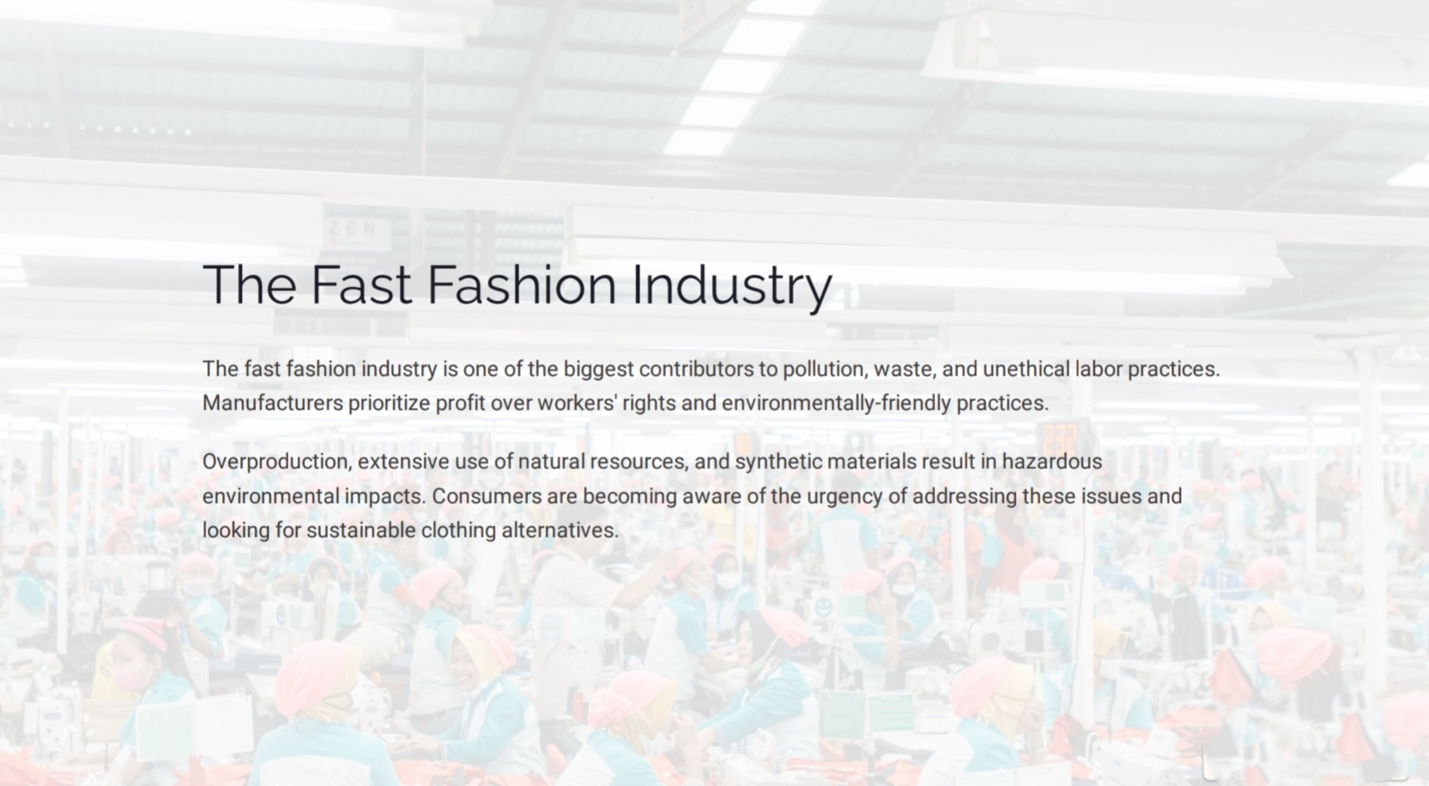

Slide 4
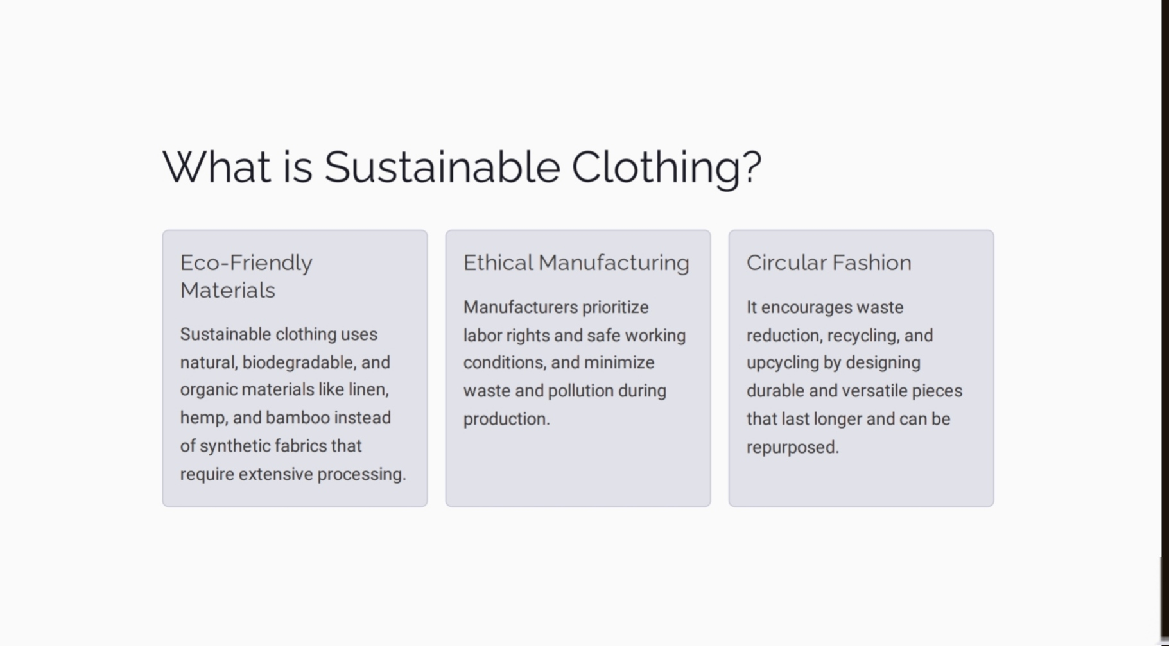

Slide 5
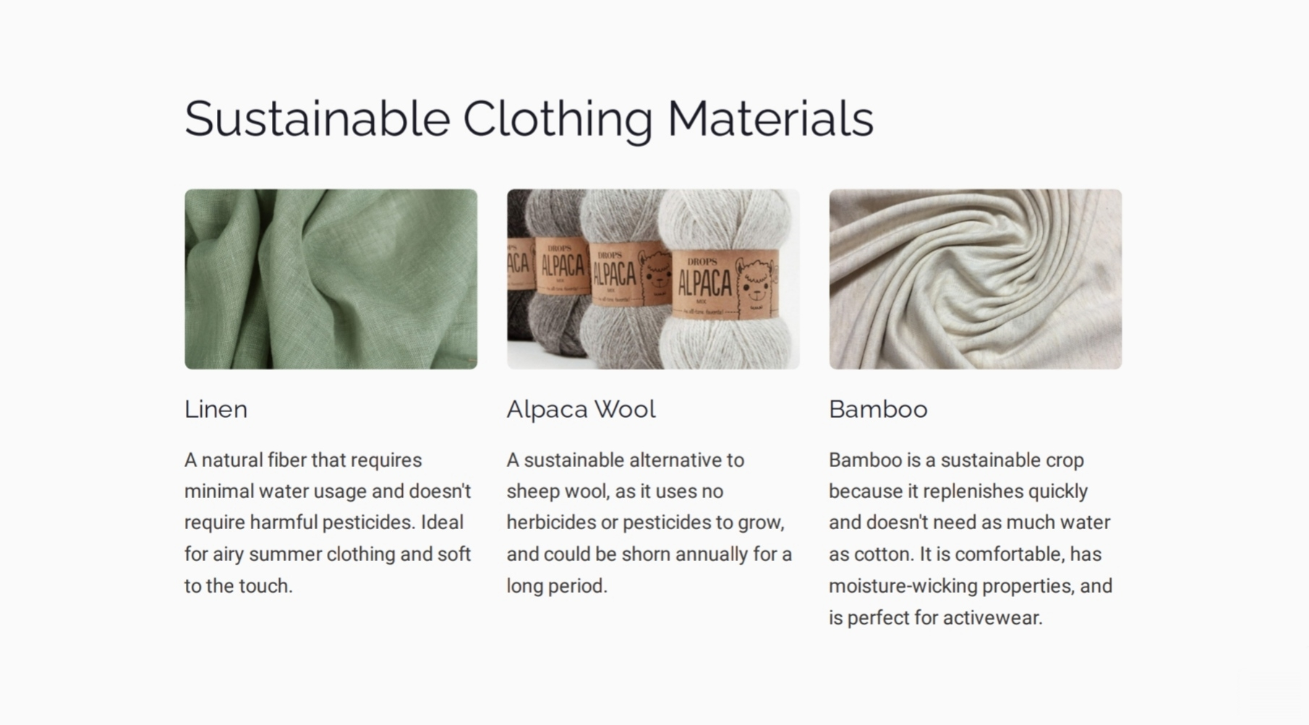

Slide 6
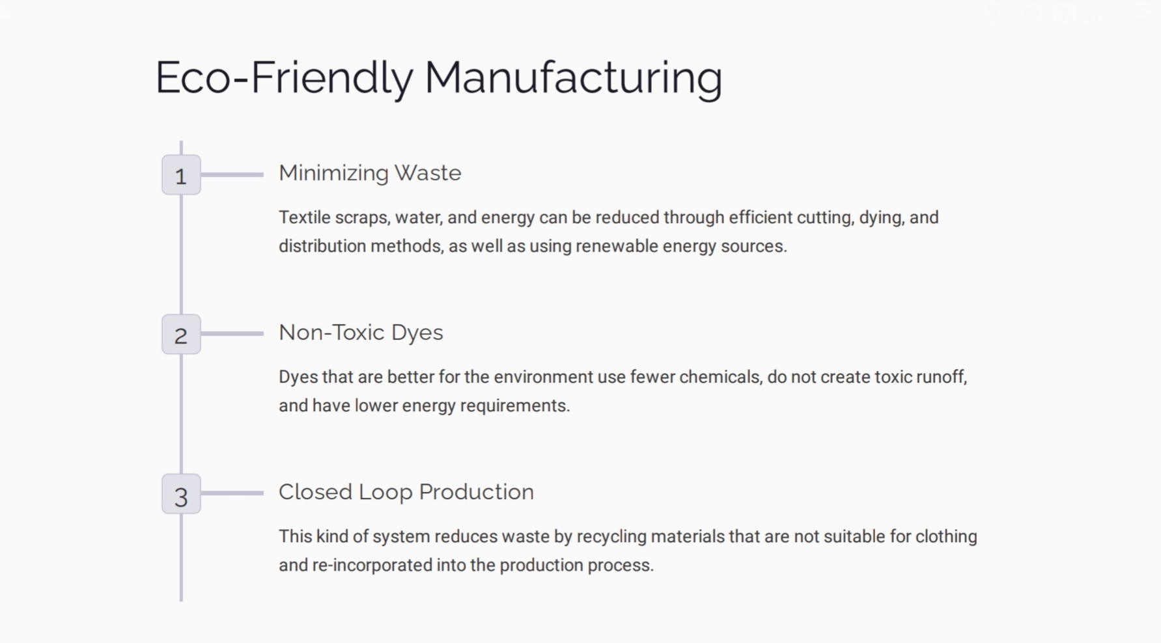

Slide 7
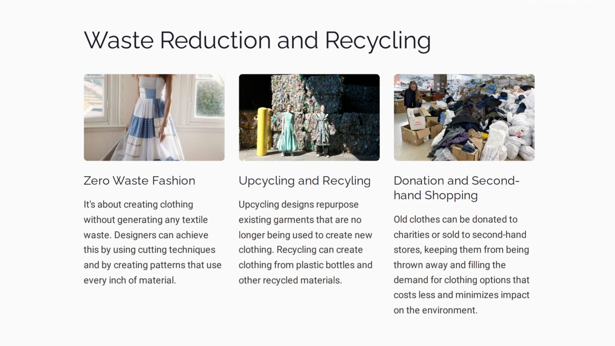

Slide 8
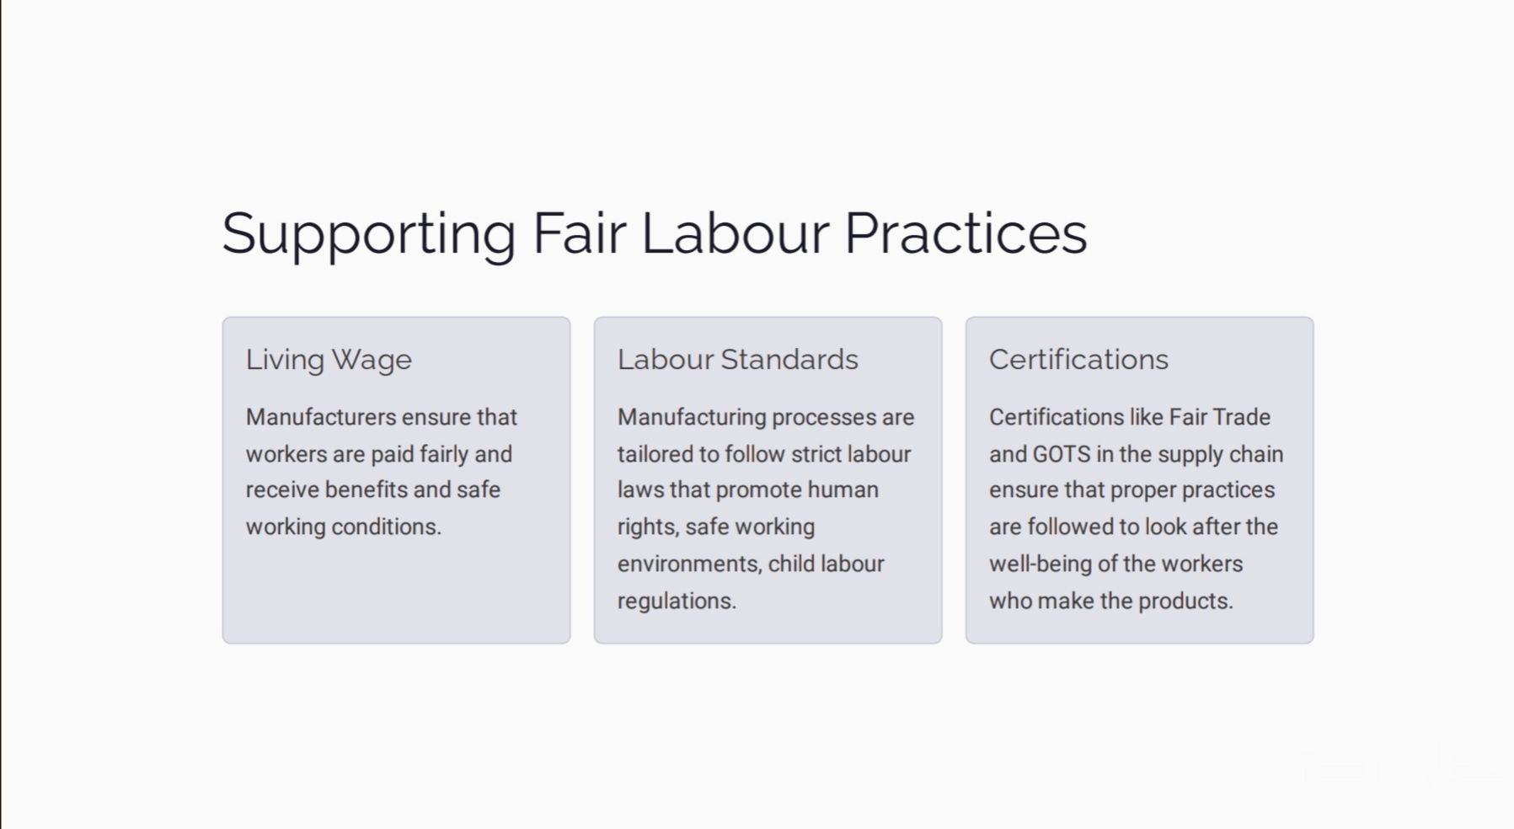

Slide 9
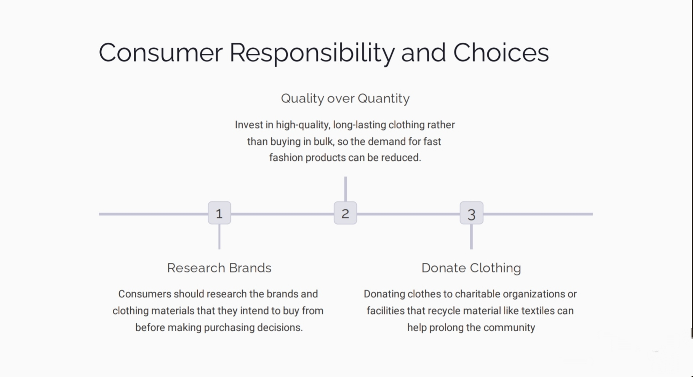

Slide 10
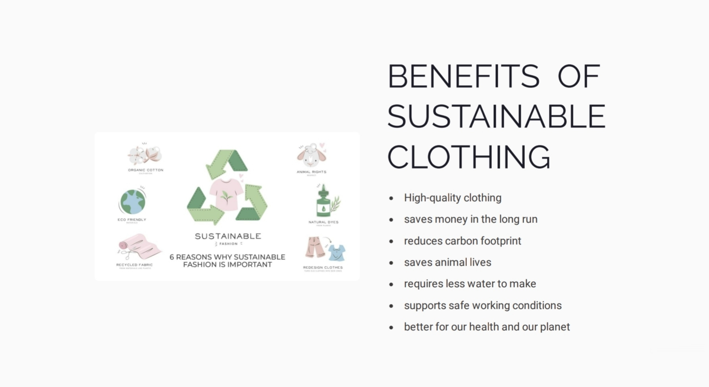

Slide 11
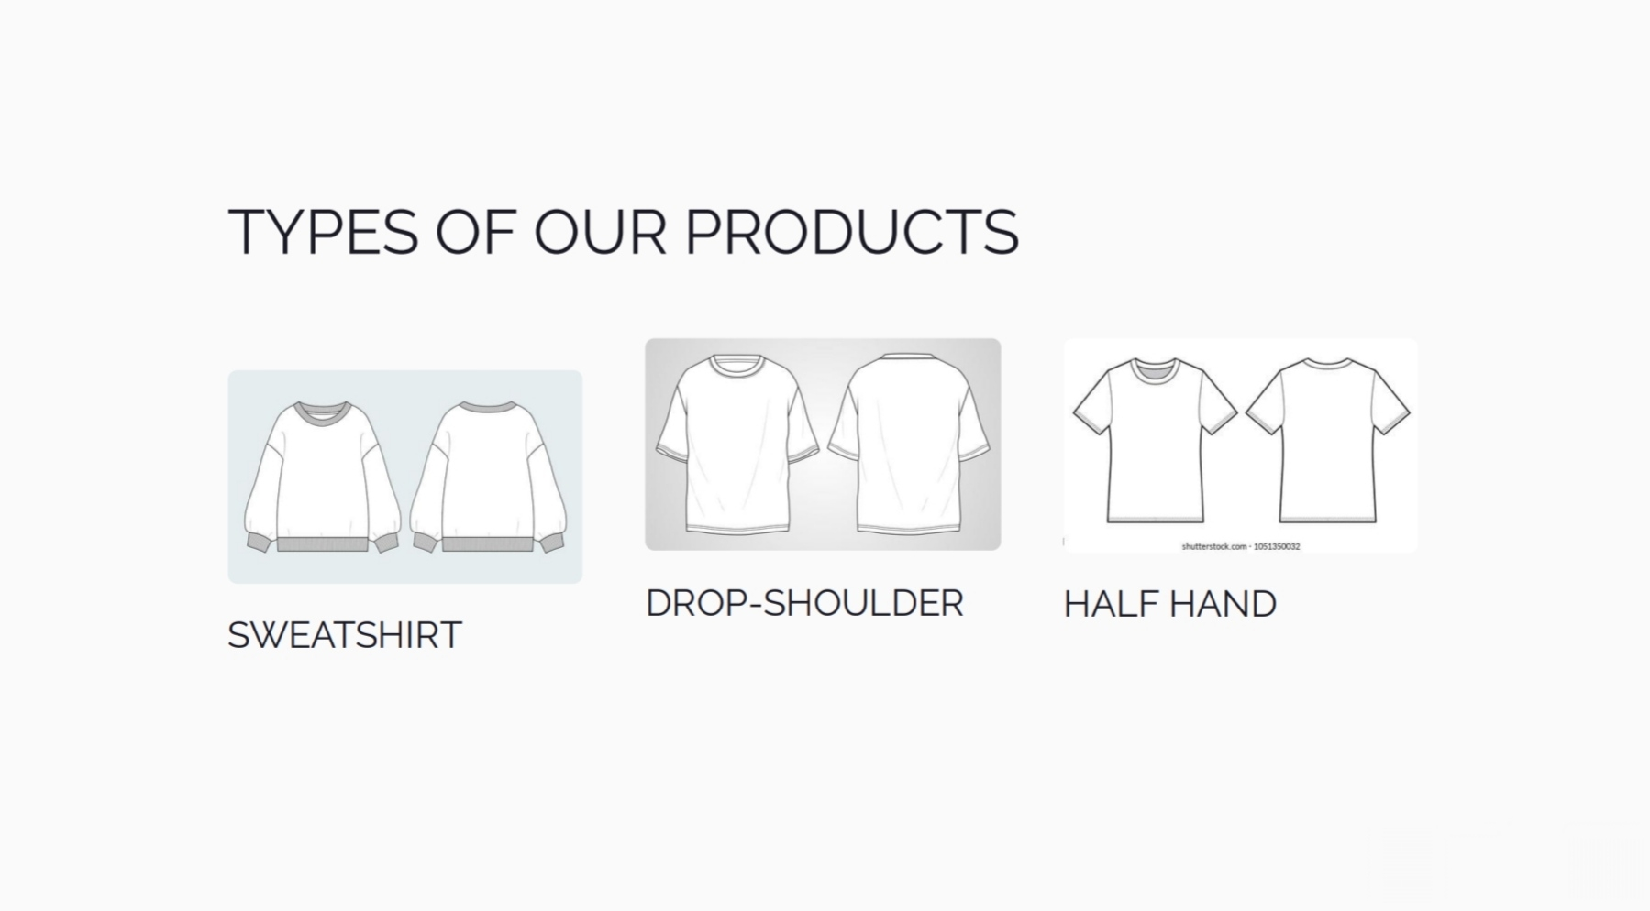

Slide 12
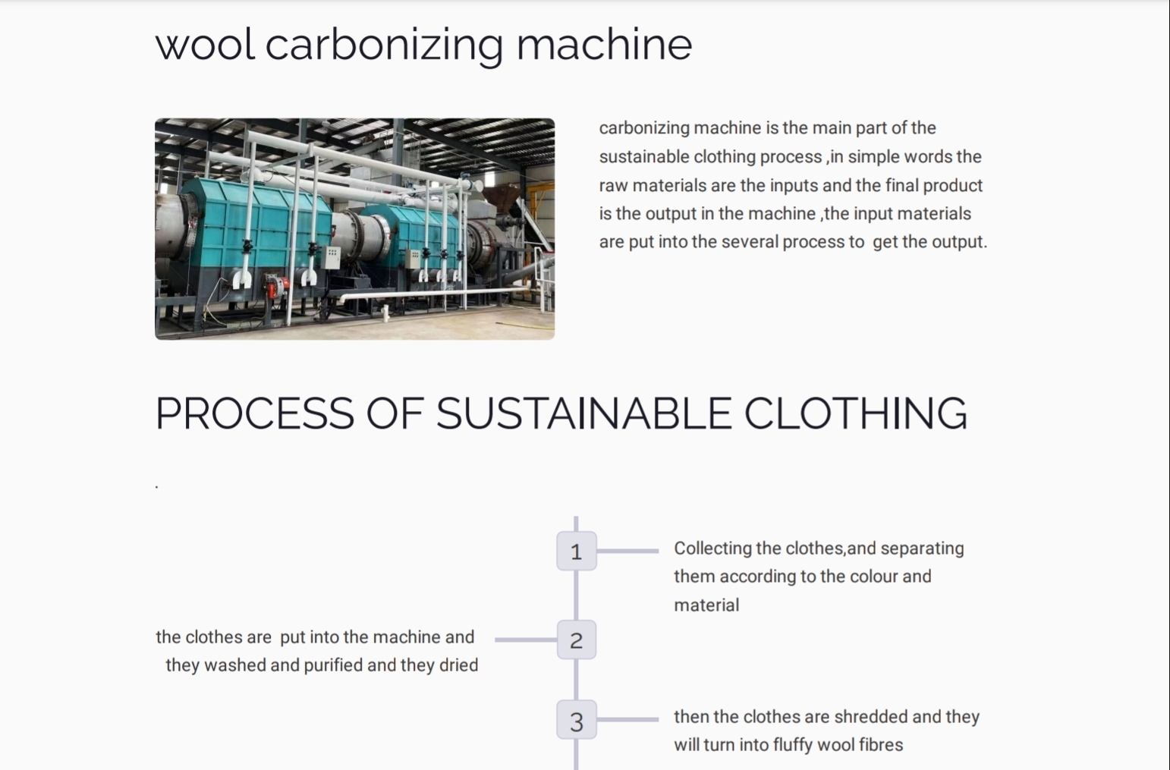

Slide 13
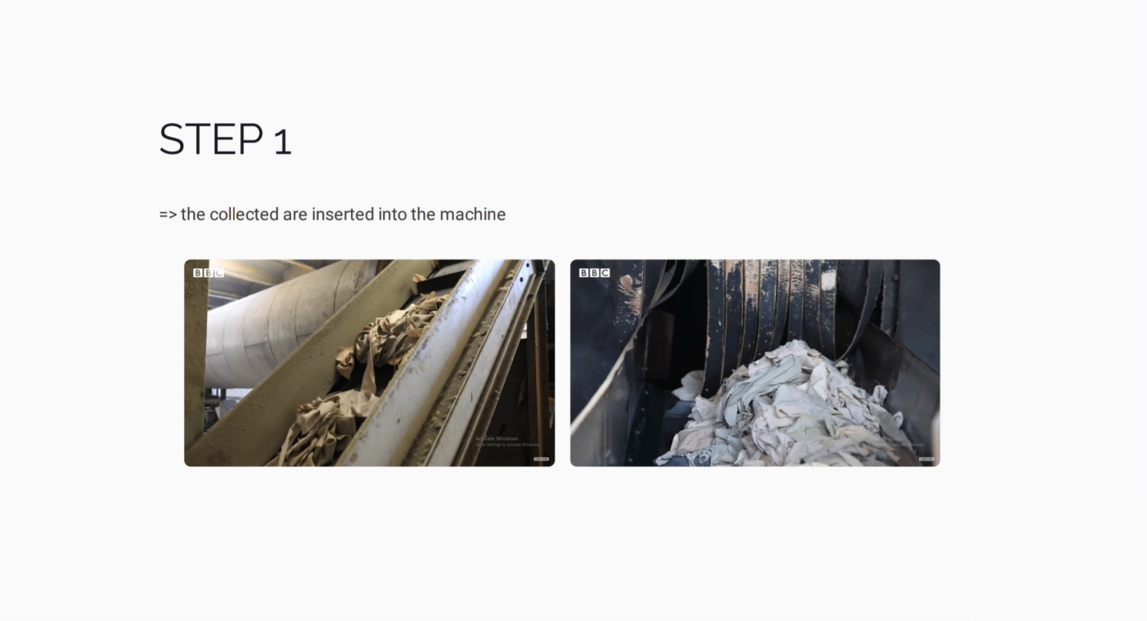

Slide 14
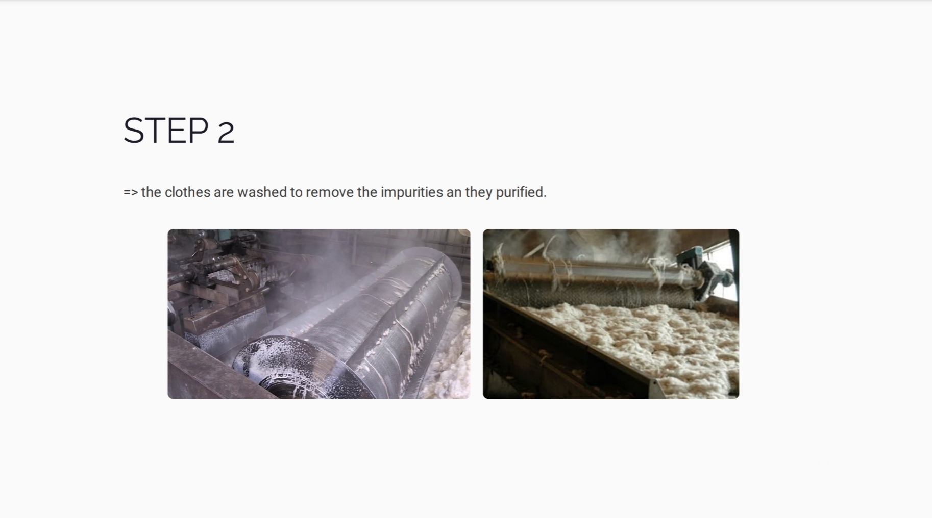

Slide 15
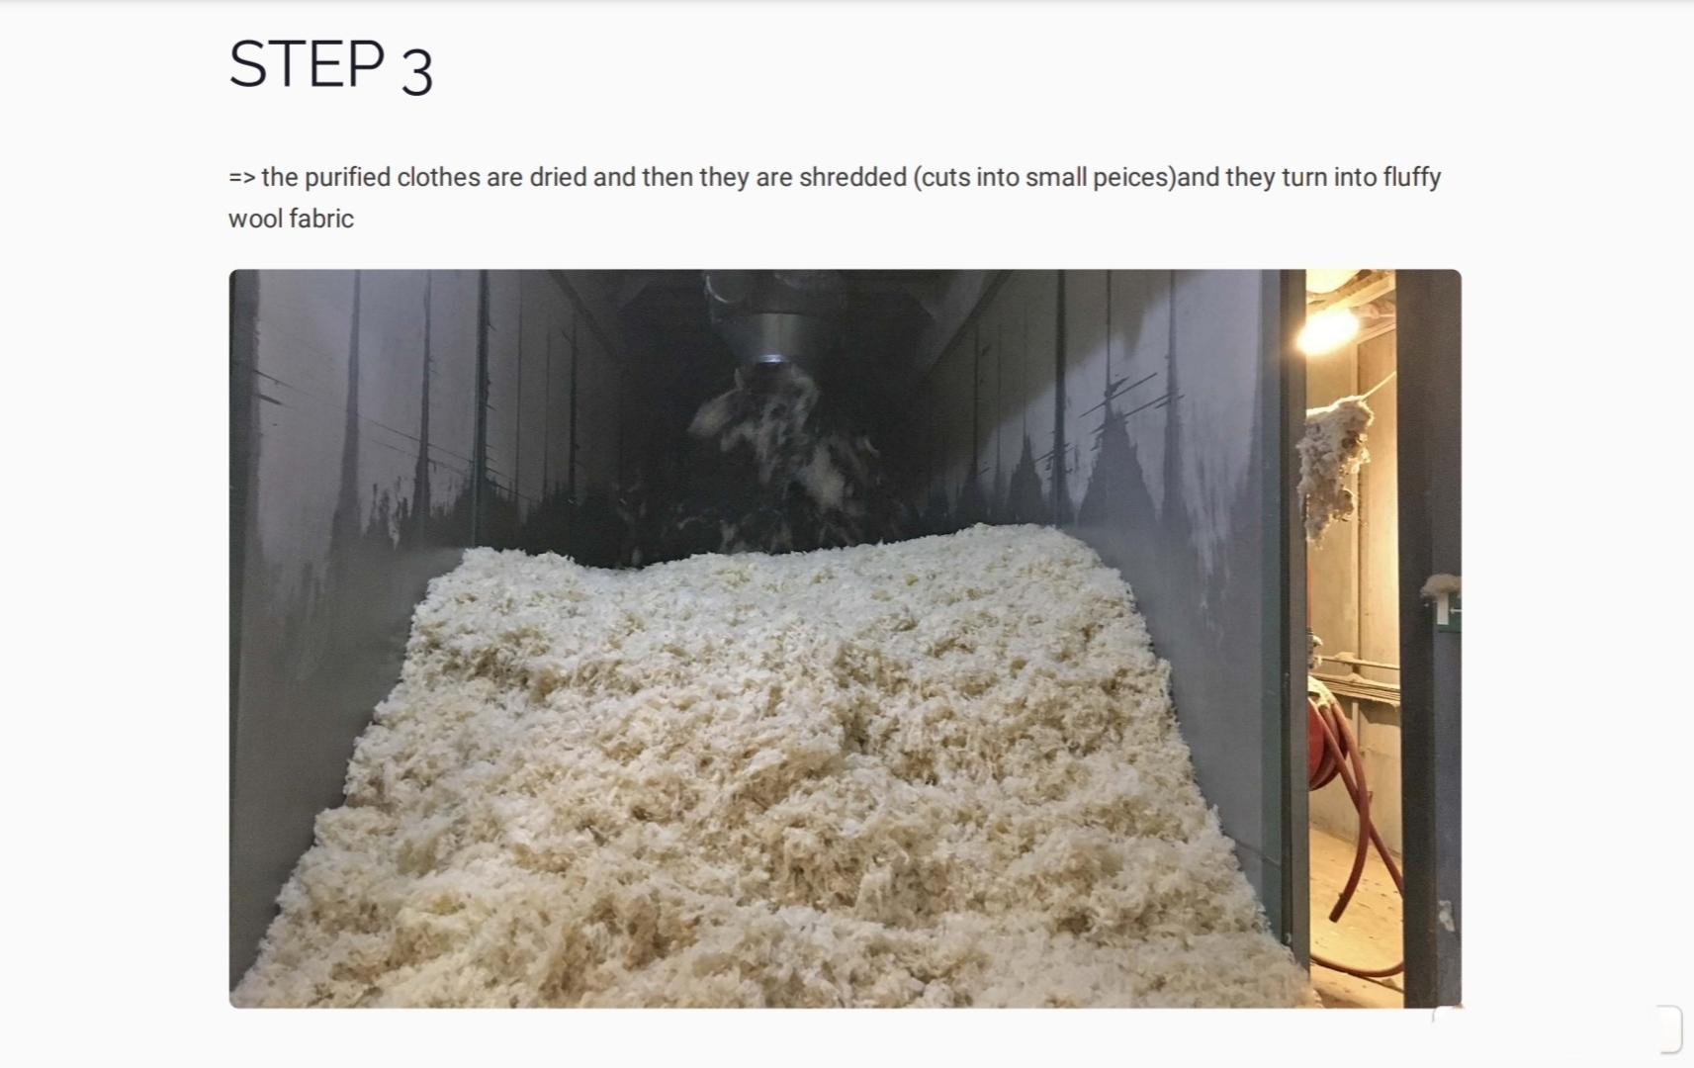

Slide 16
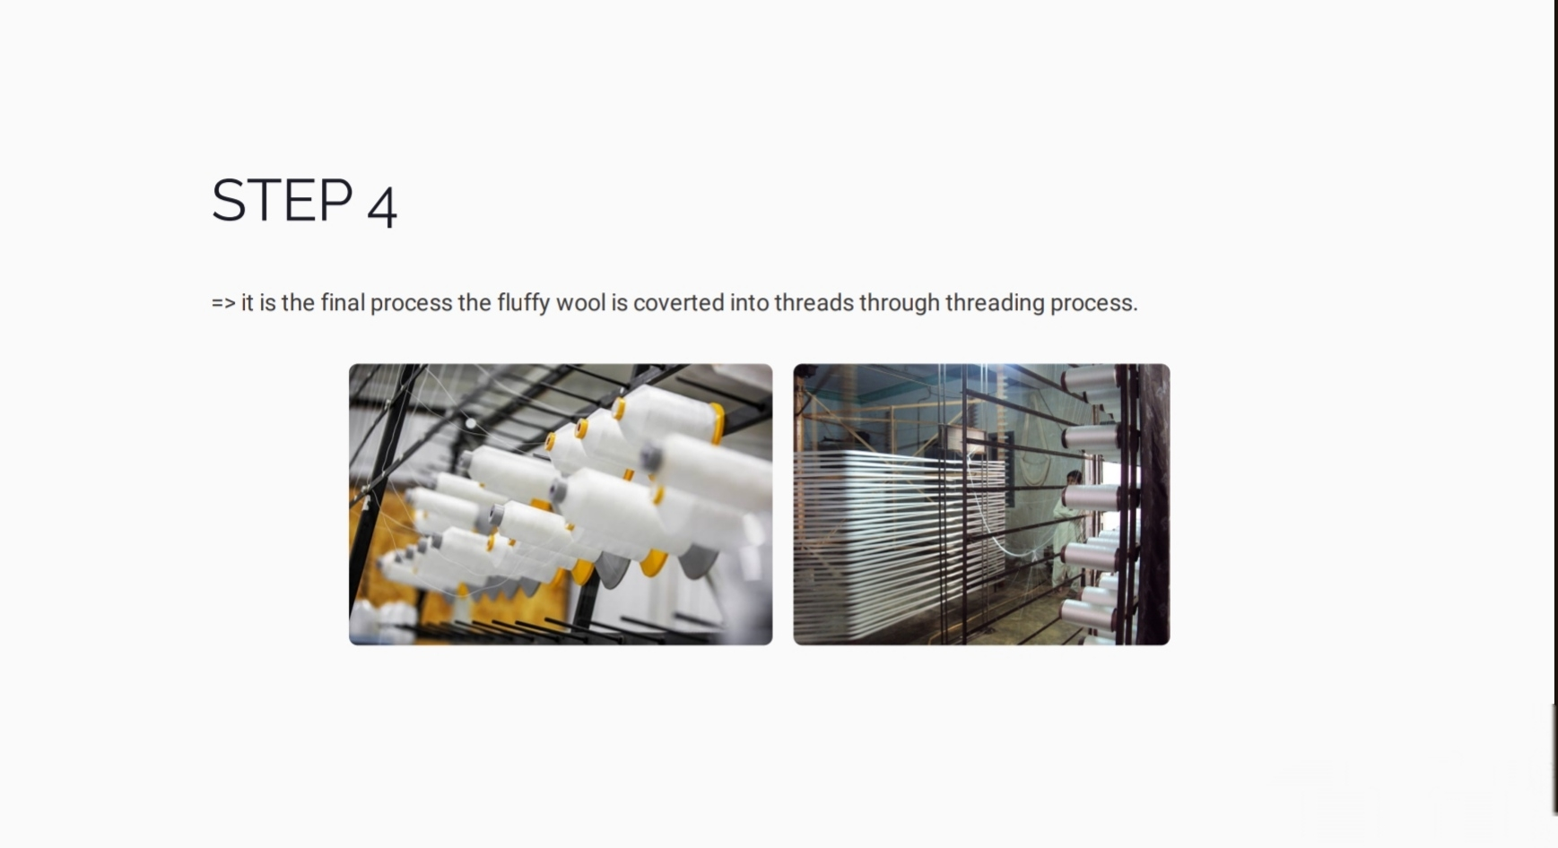

Slide 17
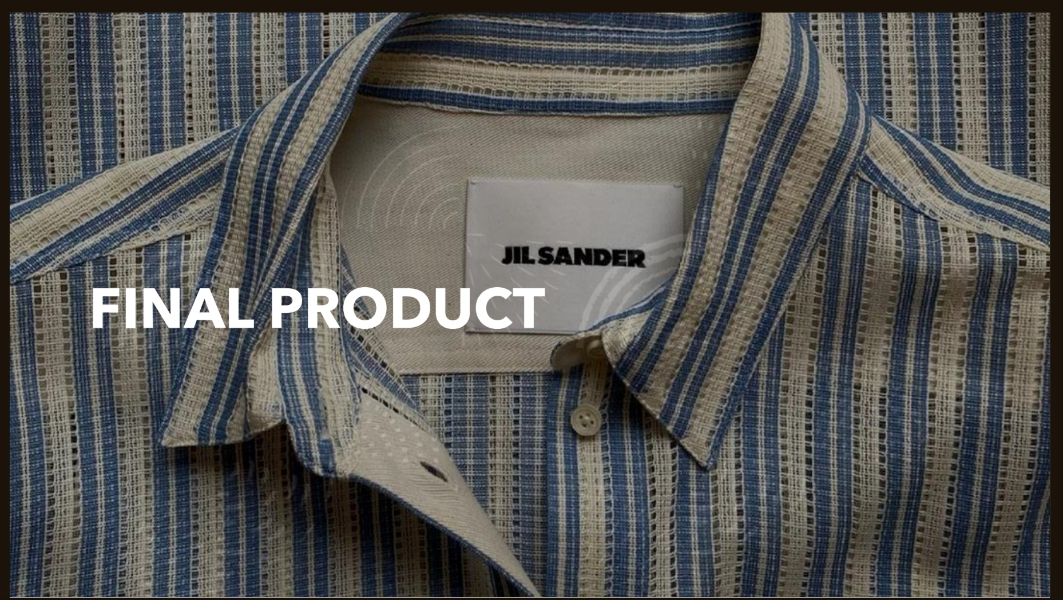

Slide 18
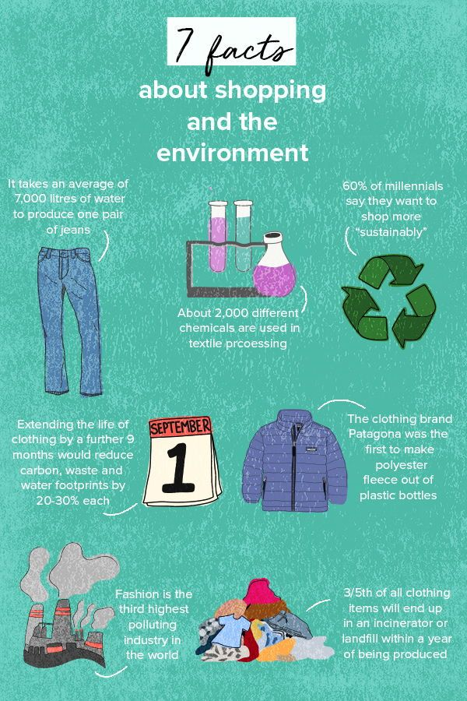

Slide 19

RECYCLE PLASTIC BOTTLES INTO ECO-FRIENDLY CLOTHES

Slide 20
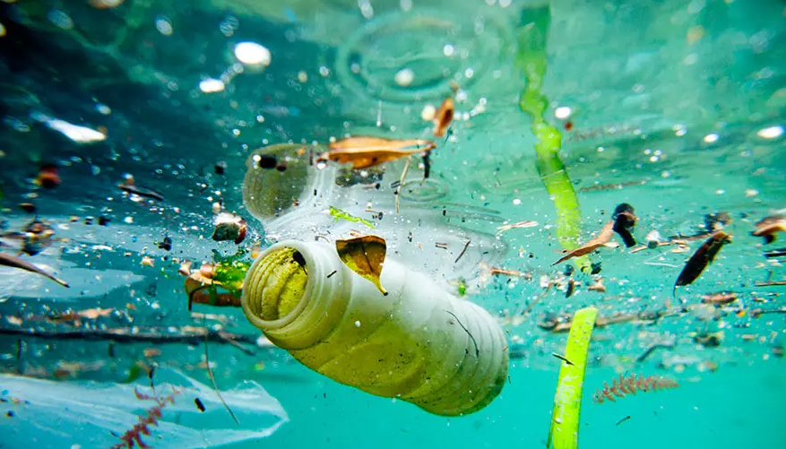
india alone flushes
1.2 million tons of plastic into ocean each year

Slide 21
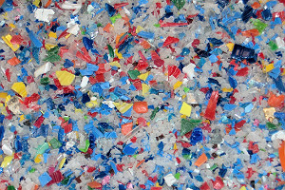
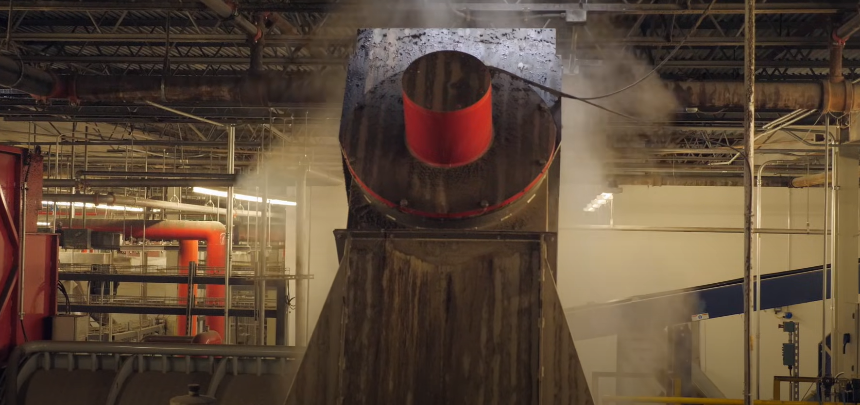
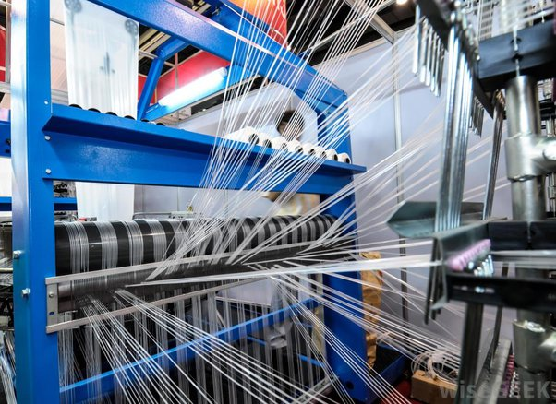
STEP 1
STEP 2
STEP 3
raw materials
2.cleaning
3.grinding
4.flakes
4.heating at high temp
5.threading

Slide 22
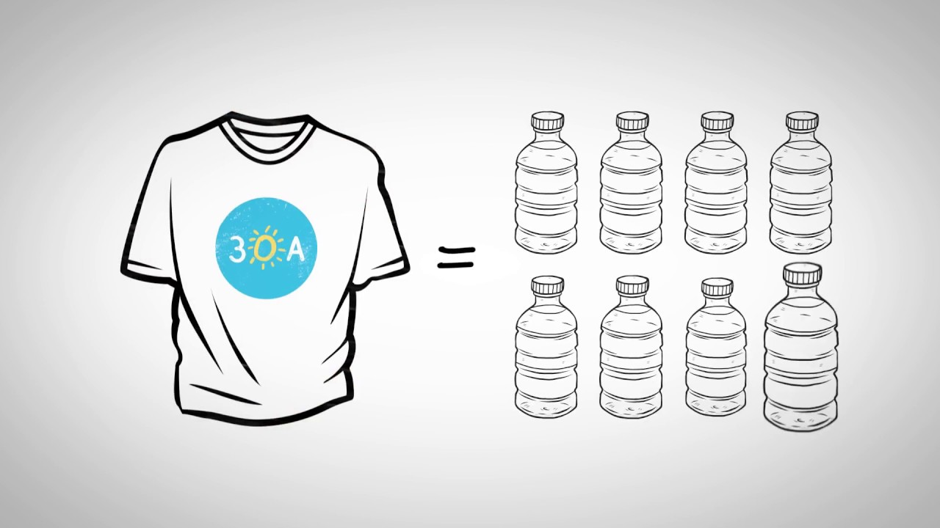
1 Tshirt = 8 petbottles

Slide 23
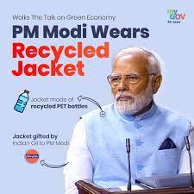
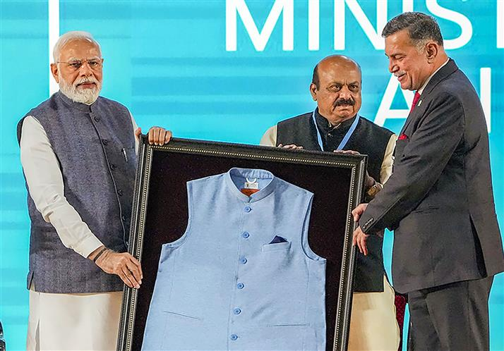
PM MODI wears recycle
jacket during G7 summit
on may 21

Slide 24

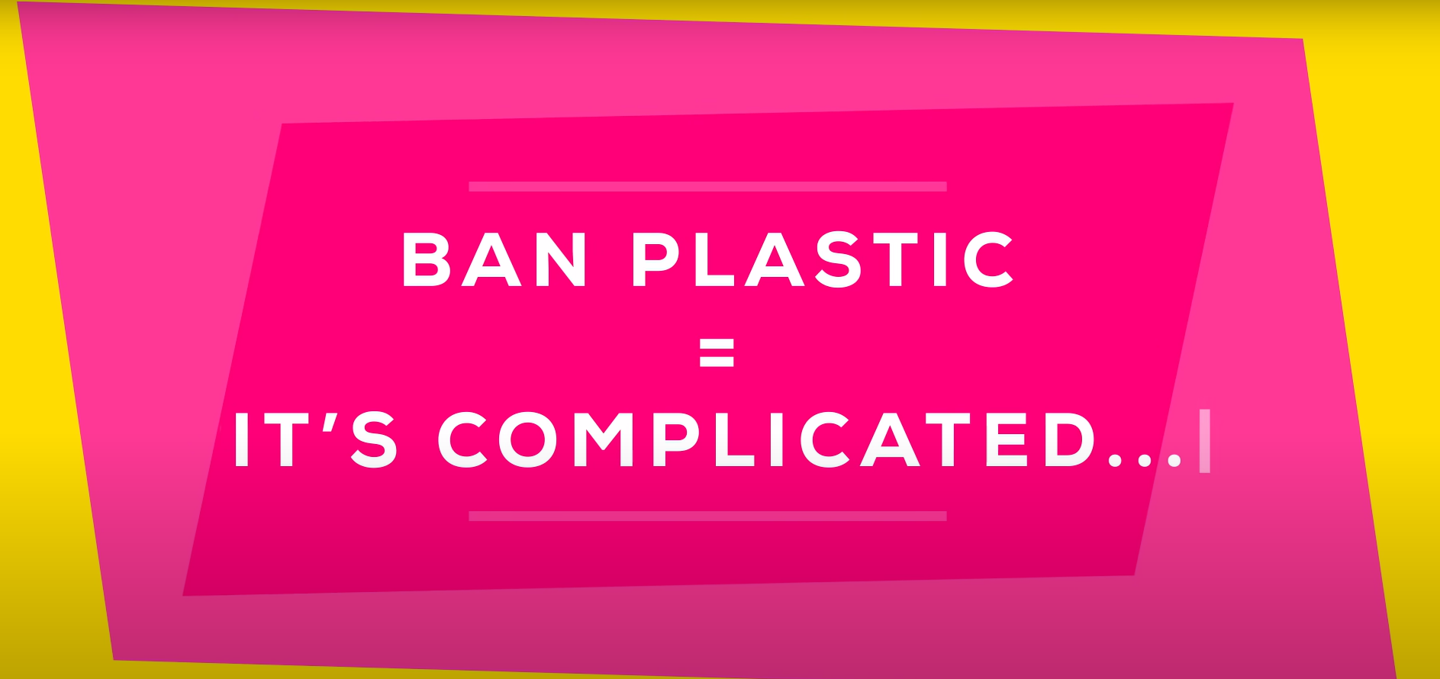

Slide 25
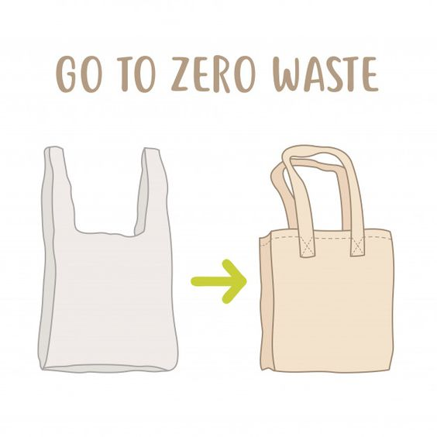
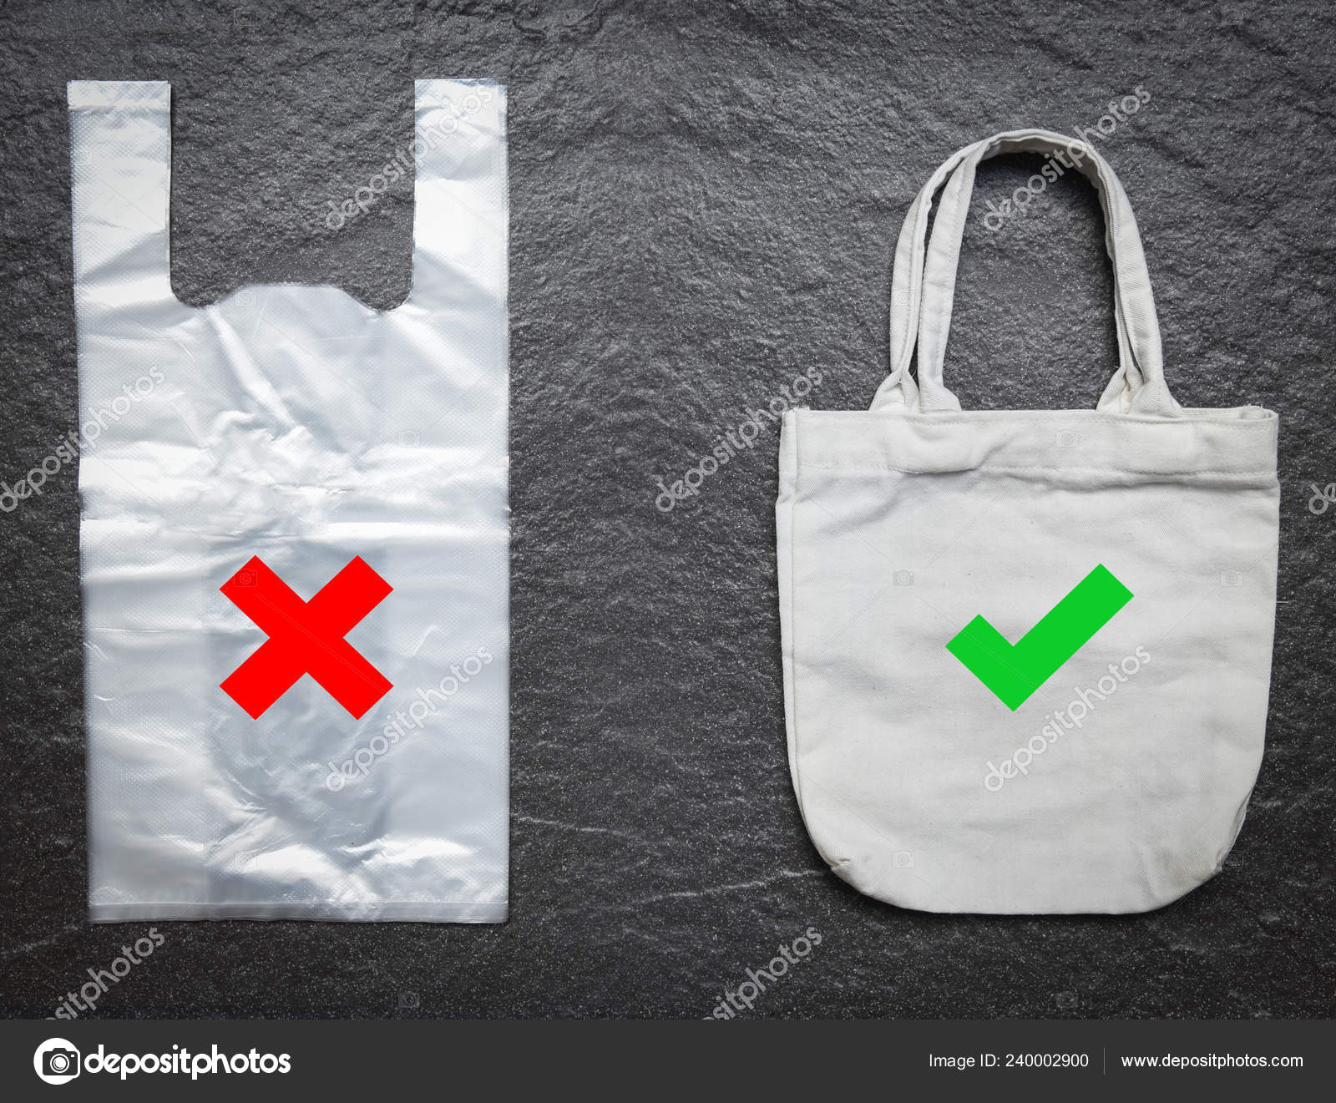
—> Plastic pollution is not the only environmental challenge we face
— > some of the substitutes we use for plastic have a higher environmental impact in other ways
—> for example: according to a recent study by the Danish government
—> making a single-use plastic bag requires so little energy and produce lower carbon
dioxide emmissions compared to a reusable cotton bag

Slide 26
Energy and Emissions:
*Plastic Bag: It takes a small amount of energy to produce a single-use plastic bag, and the resulting carbon dioxide emissions are relatively low.
*Cotton Bag: Manufacturing a cotton bag requires significantly more energy, and the process emits much more carbon dioxide compared to producing a plastic bag.
Environmental Impact
—> The environmental impact includes the total energy consumption and carbon dioxide emissions over the lifecycle of the bag.
—> Because of the high energy and emissions cost of making a cotton bag, it needs to be reused many times to offset its initial environmental impact.
Usage Comparison
For a cotton bag to become environmentally friendlier than a plastic bag, it must be reused 7,100 times. This number is derived from the comparison of the total environmental impact (energy and emissions) of both types of bags over their respective lifespans.

Slide 27
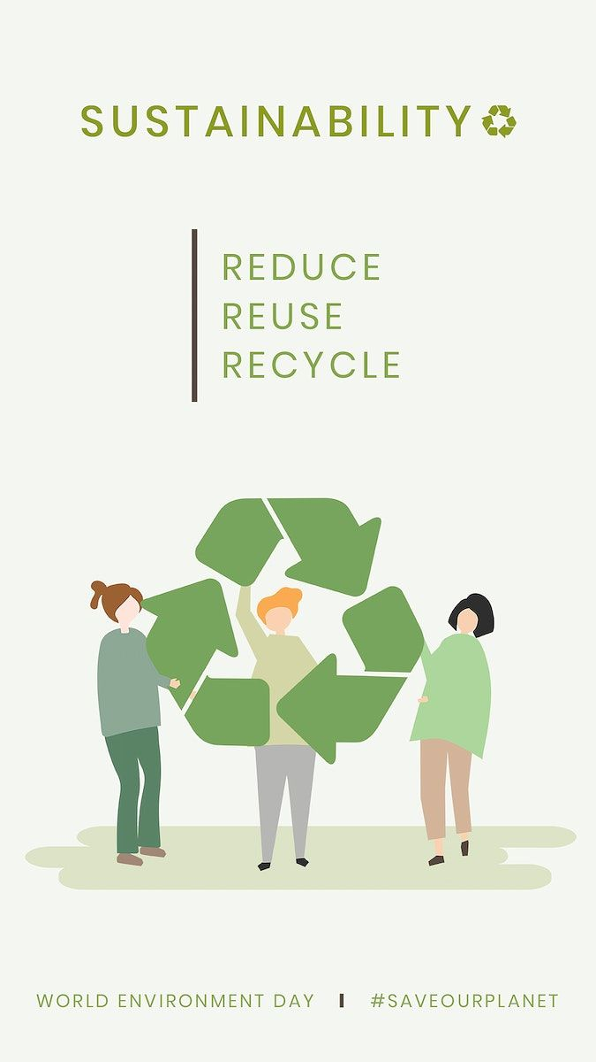

Slide 28



Slide 29


